Slide 1
Lecture 11
Sorting 2
EECS-214

Slide 2
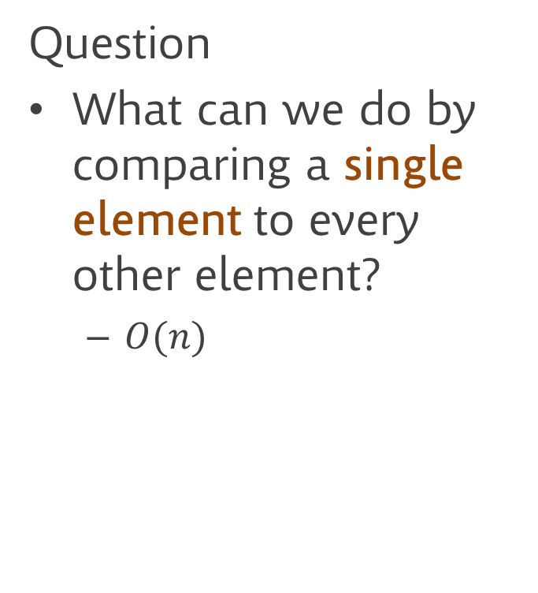
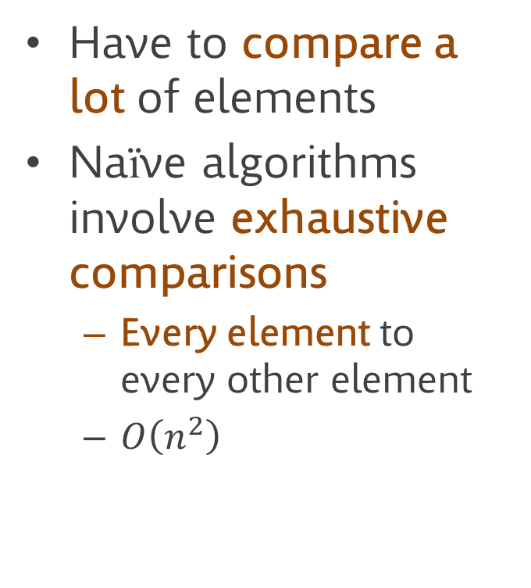
Why is sorting hard?
Have to compare a lot of elements
Naïve algorithms involve exhaustive comparisons
  Every element to every other element
  $O\left(n^{2}\right)$
Question
What can we do by comparing a single element to every other element?
  $O(n)$

Slide 3
Partitioning
pivot
Comparing one element to all the others lets us divide the array into the elements
  less than,
  greater than,
  and equal to the original element
This is called partitioning the array
  And the element being compared to is called the pivot element
9
3
7
4
8
less than pivot
(but not sorted)
greater than pivot
(but not sorted)

Slide 4
Partitioning
pivot
Partitioning makes the array “more sorted”
But we’re not done yet
  The left- and right- sides aren’t sorted internally
What can we do to finish sorting?
4
3
7
9
8
less than pivot
(but not sorted)
greater than pivot
(but not sorted)

Slide 5
Partitioning
pivot
Recurse!
Use partitioning to make the left and right sides more sorted too
Keep going until everything is fully sorted
4
3
7
9
8

Slide 6
Quicksort (Hoare, 1960)
One of the most famous algorithms in computer science
Approximately sorts whole array
Recurses to complete sorting of each half
Quicksort(array)
select pivot element
partition about pivot
Quicksort(left side)
Quicksort(right side)

Slide 7
Quicksort (Hoare, 1960)
This code is pretty hand-wavy
  For example what does it mean to call quicksort of the left side of the array?
  Also, there’s nothing to stop the recursion
Making it more rigorous is straightforward
  But there are more confusing details
  So it’s good to understand the basic idea first
Quicksort(array)
select pivot element
partition about pivot
Quicksort(left side)
Quicksort(right side)

Slide 8
Implementing partitioning
Basic idea
Move pivot to the right (the end)
Sweep from left to right
  If you see an element that’s less than the pivot
  Swap it with something on the left that’s bigger than the pivot
Move pivot between the less-than and greater-than elements
Partition(a, pIndex)
pValue = a[pIndex]
// Move pivot to end
swap a[pIndex]
with last element of a
// Move small values left
nextLeft = 0
for i = 0 to a.Length-1
if a[i]<=pValue
swap a[i]
with a[nextLeft]
nextLeft++
// Move the pivot into place
swap a[nextLeft]
with last element of a

Slide 9
Implementing partitioning
This algorithm is a little inscrutable
This is an algorithm that induces a kind of behavior in textbook writers that I hate: the pseudoexplanation
Partition(a, pIndex)
pValue = a[pIndex]
// Move pivot to end
swap a[pIndex]
with last element of a
// Move small values left
nextLeft = 0
for i = 0 to a.Length-1
if a[i]<=pValue
swap a[i]
with a[nextLeft]
nextLeft++
// Move the pivot into place
swap a[nextLeft]
with last element of a

Slide 10
Implementing partitioning
Wikipedia’s pseudoexplanation:
“This is the in-place partition algorithm. It partitions … the array … by moving all elements less than or equal to [the pivot value] to the beginning of the subarray, leaving all the greater elements following them”
This is simply a restatement of what the procedure should do
It’s not an explanation of why it works
Partition(a, pIndex)
pValue = a[pIndex]
// Move pivot to end
swap a[pIndex]
with last element of a
// Move small values left
nextLeft = 0
for i = 0 to a.Length-1
if a[i]<=pValue
swap a[i]
with a[nextLeft]
nextLeft++
// Move the pivot into place
swap a[nextLeft]
with last element of a

Slide 11
Implementing partitioning
Okay, why does it actually work?
Partition(a, pIndex)
pValue = a[pIndex]
// Move pivot to end
swap a[pIndex]
with last element of a
// Move small values left
nextLeft = 0
for i = 0 to a.Length-1
if a[i]<=pValue
swap a[i]
with a[nextLeft]
nextLeft++
// Move the pivot into place
swap a[nextLeft]
with last element of a

Slide 12
Implementing partitioning
pivot
Claim: the loop maintains the invariants that:
Elements before nextLeft
are ≤ the pivot
Elements between nextLeft and i, but not including i, are > the pivot
≤pivot
>pivot
unknown
nextLeft
i

Slide 13
Implementing partitioning
pivot
Theorem: on each iteration of the for loop:
  For any j:
  a[j] ≤ pivot, if j<nextLeft
  a[j] > pivot, if nextLeft≤j<i
Proof:
For the first iteration, i=nextLeft=0
So there are no j<nextLeft or j<i
So it’s trivially true
<pivot
>pivot
unknown
nextLeft
i

Slide 14
Implementing partitioning
pivot
Theorem: on each iteration of the for loop:
  For any j:
  a[j] ≤ pivot, if j<nextLeft
  a[j] > pivot, if nextLeft≤j<i
Proof:
Now assume it’s true at the end of iteration i-1
Let’s show it’s true at the end of iteration i
<pivot
>pivot
unknown
nextLeft
i

Slide 15
Implementing partitioning
pivot
Theorem: on each iteration of the
for loop:
  For any j:
  a[j] ≤ pivot, if j<nextLeft
  a[j] > pivot, if nextLeft≤j<i
Proof:
So we know
  a[j] ≤ pivot, for j<nextLeft
  a[j] > pivot, for nextLeft≤j<i-1
Case 1: a[i] > pivot
  Don’t do anything
  So a[j] still ≤ pivot, for j<nextLeft
  a[j] still > pivot, for nextLeft≤j<i-1
  but a[i] also > pivot, so
  a[j] > pivot, for nextLeft≤j<i
<pivot
>pivot
unknown
nextLeft
i

Slide 16
Implementing partitioning
pivot
Theorem: on each iteration of the
for loop:
  For any j:
  a[j] ≤ pivot, if j<nextLeft
  a[j] > pivot, if nextLeft≤j<i
Proof:
So we know
  a[j] ≤ pivot, for j<nextLeft
  a[j] > pivot, for nextLeft≤j<i-1
Case 2: a[i] ≤ pivot
  We swap a[i] and a[nextLeft]
    a[nextLeft] is now ≤ pivot
  And we increment nextLeft
  So once again, a[j] ≤ pivot, for j<nextLeft
<pivot
>pivot
unknown
nextLeft
i

Slide 17
Implementing partitioning
pivot
Theorem: on each iteration of the
for loop:
  For any j:
  a[j] ≤ pivot, if j<nextLeft
  a[j] > pivot, if nextLeft≤j<i
Proof:
So we know
  a[j] ≤ pivot, for j<nextLeft
  a[j] > pivot, for nextLeft≤j<i-1
Case 2: a[i] ≤ pivot
  We swap a[i] and a[nextLeft]
    This also means a[i] is now > pivot
  a[j] still > pivot, for nextLeft≤j<i-1
  but a[i] also > pivot, so
  a[j] > pivot, for nextLeft≤j<i
<pivot
>pivot
unknown
nextLeft
i

Slide 18
Implementing partitioning
pivot
Theorem: on each iteration of the
for loop:
  For any j:
  a[j] ≤ pivot, if j<nextLeft
  a[j] > pivot, if nextLeft≤j<i
Proof:
So by induction, the theorem holds for each iteration
<pivot
>pivot
unknown
nextLeft
i

Slide 19
Implementing partitioning
pivot
Theorem: on each iteration of the
for loop:
  For any j:
  a[j] ≤ pivot, if j<nextLeft
  a[j] > pivot, if nextLeft≤j<i
Corollary: the algorithm works
We run until i gets up to the end (where the pivot element is)
Everything before nextLeft is ≤ pivot
Everything from nextLeft to pivot is > pivot
Then we swap nextLeft (which is > pivot) with the pivot
So we end up with:
  Before nextLeft is ≤ pivot
  nextLeft is the pivot
  After nextLeft is > the pivot
Yay!
<pivot
>pivot
unknown
nextLeft
i

Slide 20
In-place partitioning
9
3
7
4
8
Pivot around 7
pIndex = 2
pValue = 7

Slide 21
In-place partitioning
9
3
7
4
8
Swap pivot to end
Pivot around 7
pIndex = 2
pValue = 7

Slide 22
In-place partitioning
9
3
8
4
7
start i, nextLeft
at the beginning
i
nextLeft
Pivot around 7
pValue = 7

Slide 23
In-place partitioning
9
3
8
4
7
a[i]<=pValue?
i
nextLeft
Pivot around 7
pValue = 7

Slide 24
In-place partitioning
9
3
8
4
7
no – move on
i
nextLeft
Pivot around 7
pValue = 7

Slide 25
In-place partitioning
9
3
8
4
7
a[i]<=pValue?
i
nextLeft
Pivot around 7
pValue = 7

Slide 26
In-place partitioning
9
3
8
4
7
yes – swap with
a[nextLeft]
i
nextLeft
Pivot around 7
pValue = 7

Slide 27
In-place partitioning
3
9
8
4
7
increment nextLeft
i
nextLeft
Pivot around 7
pValue = 7

Slide 28
In-place partitioning
3
9
8
4
7
next i
i
nextLeft
Pivot around 7
pValue = 7

Slide 29
In-place partitioning
3
9
8
4
7
a[i] < pValue?
i
nextLeft
Pivot around 7
pValue = 7

Slide 30
In-place partitioning
3
9
8
4
7
no – move on
i
nextLeft
Pivot around 7
pValue = 7

Slide 31
In-place partitioning
3
9
8
4
7
a[i]<=pValue?
i
nextLeft
Pivot around 7
pValue = 7

Slide 32
In-place partitioning
3
9
8
4
7
yes - swap
i
nextLeft
Pivot around 7
pValue = 7

Slide 33
In-place partitioning
3
4
8
9
7
increment nextLeft
i
nextLeft
Pivot around 7
pValue = 7

Slide 34
In-place partitioning
3
4
8
9
7
move on
i
nextLeft
Pivot around 7
pValue = 7

Slide 35
In-place partitioning
3
4
8
9
7
oops –
we’re at the pivot
i
nextLeft
Pivot around 7
pValue = 7

Slide 36
In-place partitioning
3
4
8
9
7
swap it into nextLeft
i
nextLeft
Pivot around 7
pValue = 7

Slide 37
In-place partitioning
3
4
7
9
8
done
Pivot around 7
pValue = 7

Slide 38
Partitioning subranges of the array
When quicksort recurses, it will need to partition just the left and right halves of the array
So we need to change partition to take the region of the array to be partitioned as an argument
  Specified by its starting and ending indices
Quicksort also needs Partition to tell it where the split is, so it will return nextLeft
Partition(a, pIndex, start, end)
pValue = a[pIndex]
// Move pivot to end
swap a[pIndex]
with a[end]
// Move small values left
nextLeft = start
for i = start to end-1
if a[i]<=pValue
swap a[i]
with a[nextLeft]
nextLeft++
// Move the pivot into place
swap a[nextLeft]
with a[end]
return nextLeft

Slide 39
The real quicksort algorithm
Quicksort(a)
QuicksortRecur(a, 0, a.Length-1)
QuicksortRecur(a, start, end)
if end>start
pIndex = … select pivot index …
newIndex = Partition(a, pIndex, start, end)
QuicksortRecur(a, start, newIndex-1)
QuicksortRecur(a, newIndex+1, end)
We’ll talk about
this part shortly …

Slide 40
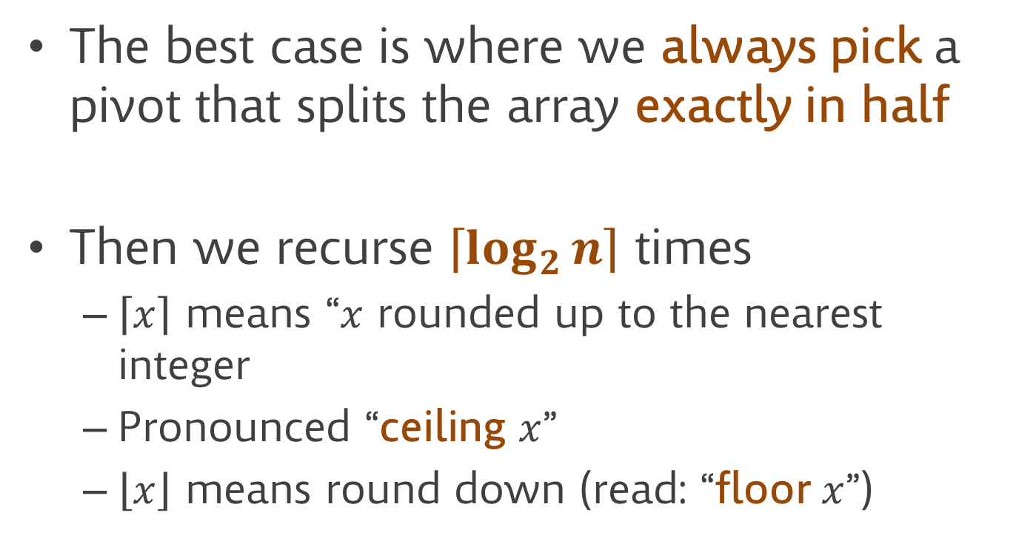
Analysis (best case)
The best case is where we always pick a pivot that splits the array exactly in half
Then we recurse $\left\lceil \log_{2}{n}\right\rceil$ times
  $\left\lceil x\right\rceil$ means “$x$ rounded up to the nearest integer
  Pronounced “ceiling $x$”
  $\left\lfloor x\right\rfloor$ means round down (read: “floor $x$”)

Slide 41
Call tree
n elements
Quicksort(n elements)
n elements
Quicksort(n/2 elements)
Quicksort(n/2 elements)
n elements
Quicksort(n/4 elts)
Quicksort(n/4 elts)
Quicksort(n/4 elts)
Quicksort(n/4 elts)
n elements
Quicksort(n/8 elts)
Quicksort(n/8 elts)
Quicksort(n/8 elts)
Quicksort(n/8 elts)
Quicksort(n/8 elts)
Quicksort(n/8 elts)
Quicksort(n/8 elts)
Quicksort(n/8 elts)
.
.
.
Note: this is somewhat hand-wavy, since each level of recursion removes one element
(the pivot) before dividing by two. But this still works as an upper bound

Slide 42

Analysis (best case)
$O(\log{n)}$ levels of recursion
$n$ items total partitioned in each level
$O(n\log{n)}$ total time

Slide 43
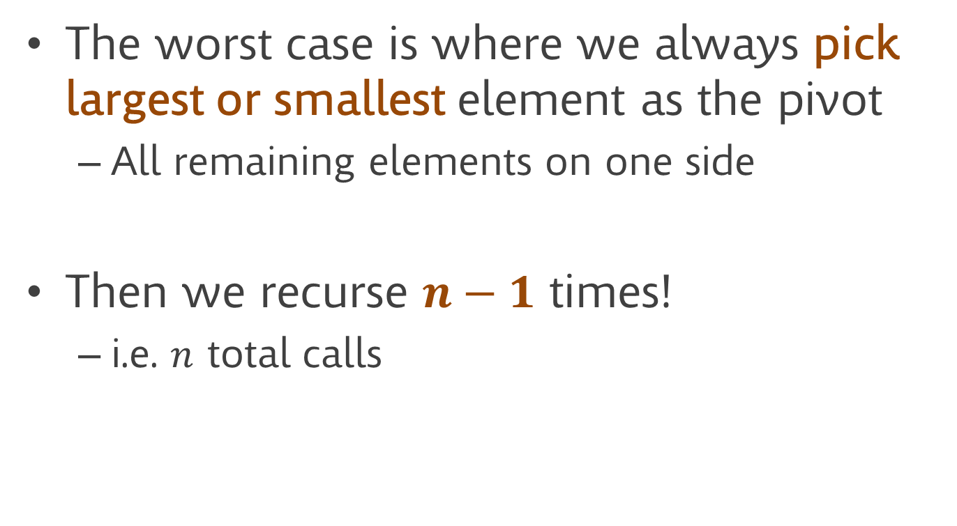
Analysis (worst case)
The worst case is where we always pick largest or smallest element as the pivot
  All remaining elements on one side
Then we recurse $n−1$ times!
  i.e. $n$ total calls

Slide 44

Analysis (worst case)
$O(n)$ levels of recursion
$O(n)$ work per level of recursion
$O(n^{2})$ total time

Slide 45
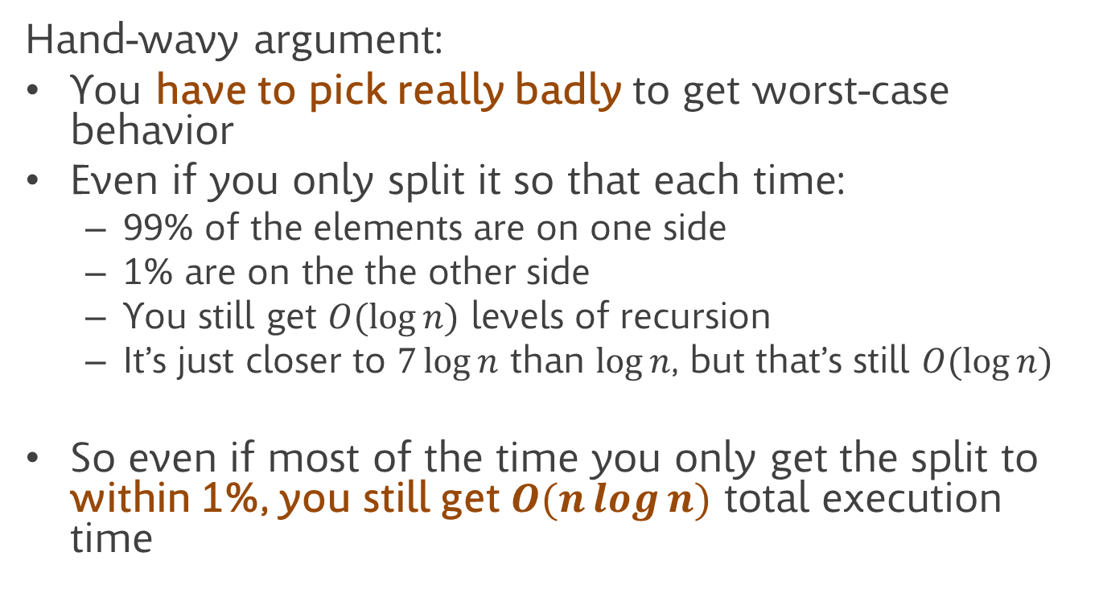
Analysis (average case)
Hand-wavy argument:
You have to pick really badly to get worst-case behavior
Even if you only split it so that each time:
  99% of the elements are on one side
  1% are on the the other side
  You still get $O(\log{n)}$ levels of recursion
  It’s just closer to $7\log{n}$ than $\log{n}$, but that’s still $O(\log{n)}$
So even if most of the time you only get the split to within 1%, you still get $O(n\log{n)}$ total execution time

Slide 46
Picking the pivot element
So the choice of the pivot determines performance
How do we choose the pivot element?

Slide 47
Technique 1: fixed choice
E.g. always pick the first or last element in the array
Usually works fine, but can give you worst-case behavior if the array is already sorted/reverse-sorted
  Example: first or last element gives you worst-case behavior on both sorted, and reverse-sorted arrays

Slide 48
Technique 2: median of 3
Grab three elements (e.g. first, last, and middle of the array)
Find the median (the one that’s between the other two
Use that as the pivot
Works well, but a sneaky adversary could cook up an array to force your sort to run slowly
  Mostly of theoretical interest

Slide 49
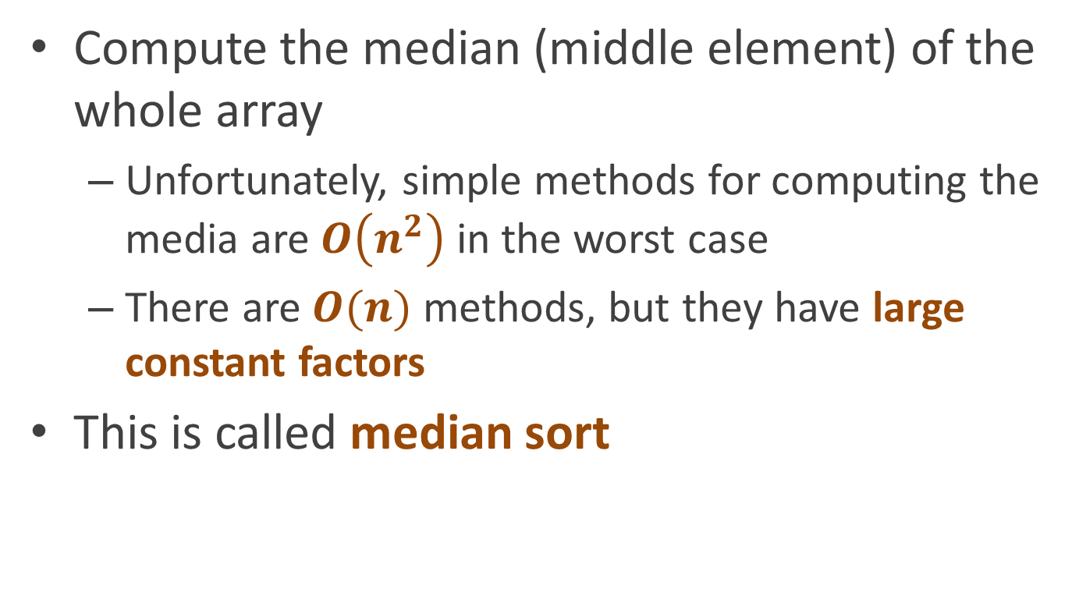
Technique 3:
Median of the whole array
Compute the median (middle element) of the whole array
  Unfortunately, simple methods for computing the media are $O\left(n^{2}\right)$ in the worst case
  There are $O(n)$ methods, but they have large constant factors
This is called median sort

Slide 50
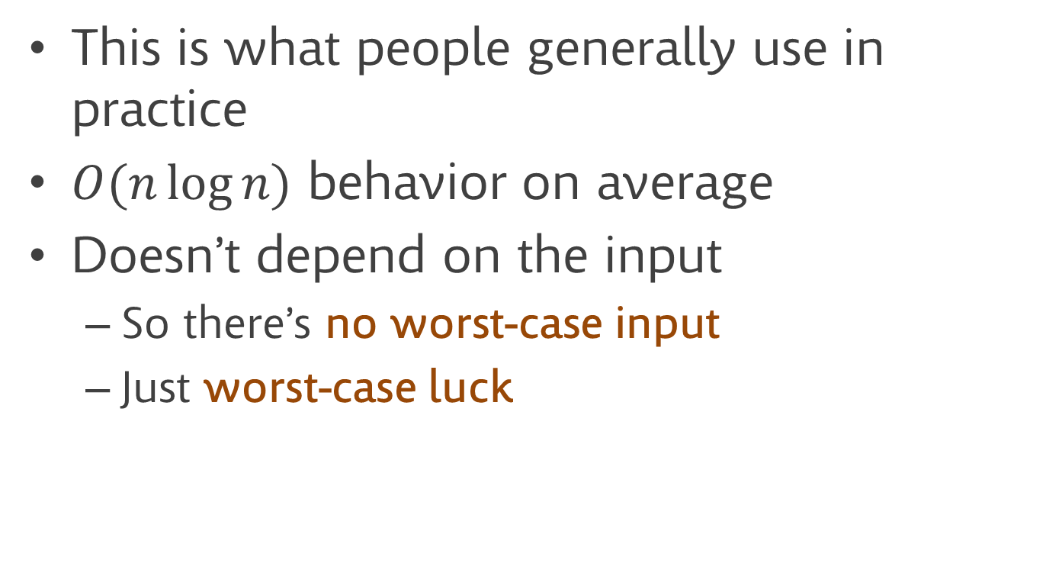
Technique 4: choose randomly
This is what people generally use in practice
$O(n\log{n)}$ behavior on average
Doesn’t depend on the input
  So there’s no worst-case input
  Just worst-case luck

Slide 51
Sorting linked lists
This is all great, but what if our data is not in an array?
Is quicksort a good choice if your data is in a linked list?

Slide 52
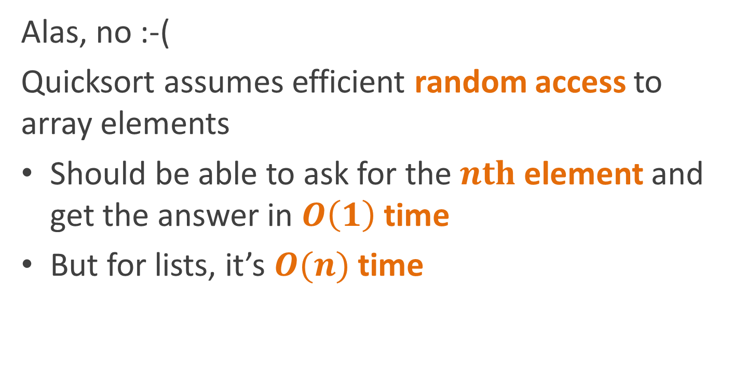
Sorting linked lists
Alas, no :-(
Quicksort assumes efficient random access to array elements
Should be able to ask for the $nth$ element and get the answer in $O\left(1\right)$ time
But for lists, it’s $O(n)$ time

Slide 53
What can we do efficiently with sorted lists?
If we want to design a sort that will be efficient for lists, we might start by asking what we can do efficiently with lists
Hints
  What can you do efficiently with lists that are already sorted?
  Think back to 111

Slide 54

Merging sorted lists
Given two sorted lists
We can merge them into one sorted list in $O\left(n\right)$ time
merge(cell1, cell2)
if (cell1== null)
return cell2
if (cell2 == null)
return cell1
if (cell1.value > cell2.value)
return
new Cell(cell2.value,
merge(cell1, cell2.next)
else
return
new Cell(cell1.value,
merge(cell1.next, cell2)

Slide 55
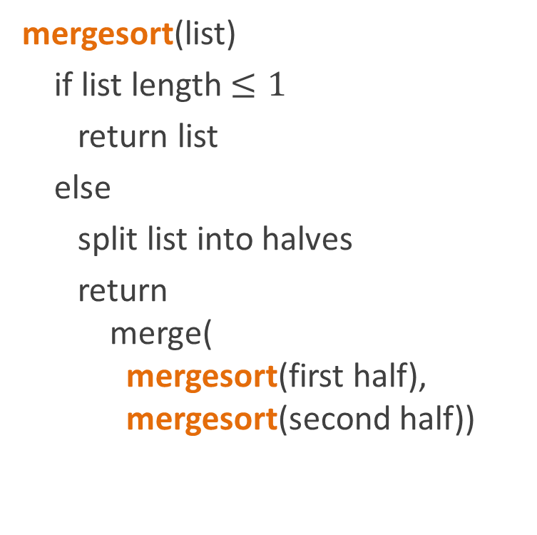
Sorting the list
How do we make a sort algorithm out of this?
  Split the list in two
  Recursively sort the two halves
  Merge the sorted halves
mergesort(list)
if list length $≤1$
return list
else
split list into halves
return
merge(
mergesort(first half),
mergesort(second half))

Slide 56
Full version of the code
merge_sort(list m) {
if m == null || m.next == null then
return m
left = empty list; right = empty list; index = 0;
foreach cell x in m {
if i is odd then
add x to left
else
add x to right
i++
}
return merge(merge_sort(left), merge_sort(right))
}

Slide 57
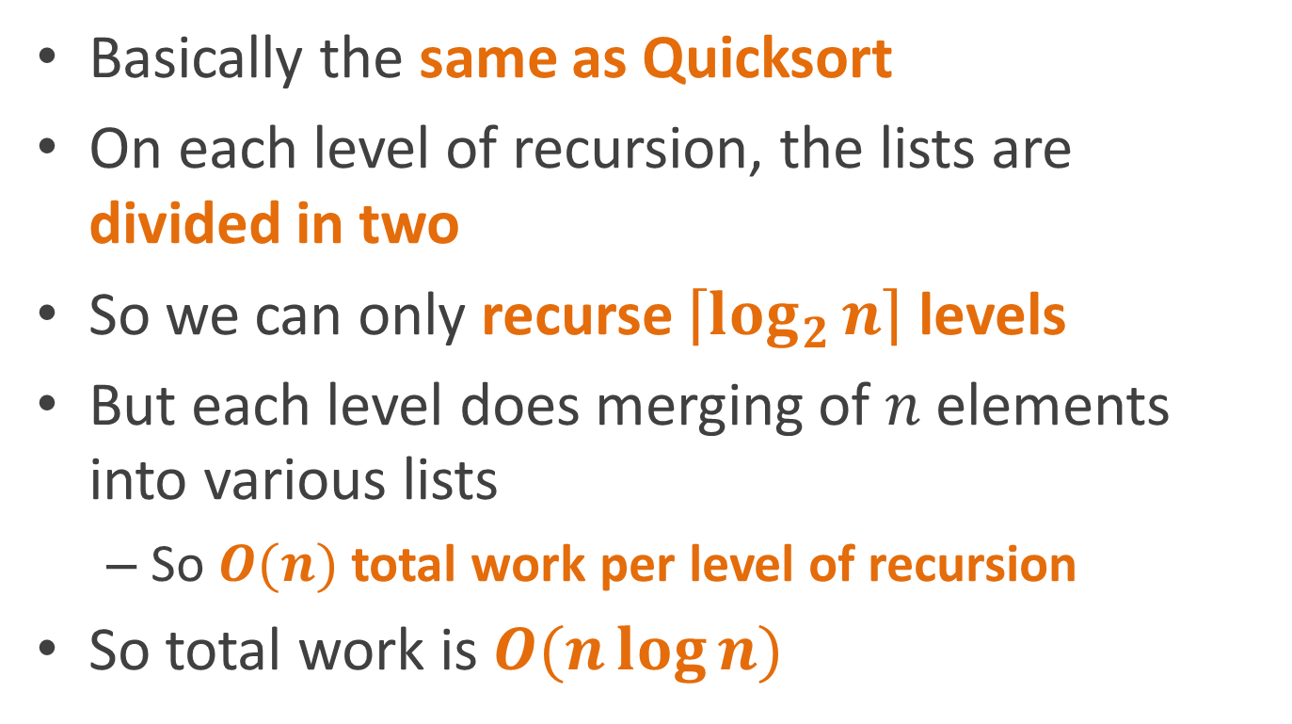
Complexity analysis
Basically the same as Quicksort
On each level of recursion, the lists are divided in two
So we can only recurse $\left\lceil \log_{2}{n}\right\rceil$ levels
But each level does merging of $n$ elements into various lists
  So $O(n)$ total work per level of recursion
So total work is $O(n\log{n})$

Slide 58
How is this different from Quicksort’s complexity?

Slide 59

How is this different from Quicksort’s complexity?
Quicksort is $O(n\log{n})$ in the average case
Merge sort is $O(n\log{n})$ in the worst case
  Because lists are always divided perfectly in half
So it’s always guaranteed $O(n\log{n})$

Slide 60
Reading
Read CLR chapter on Quicksort (chapter 8/9, depending on edition)

